Slide 1
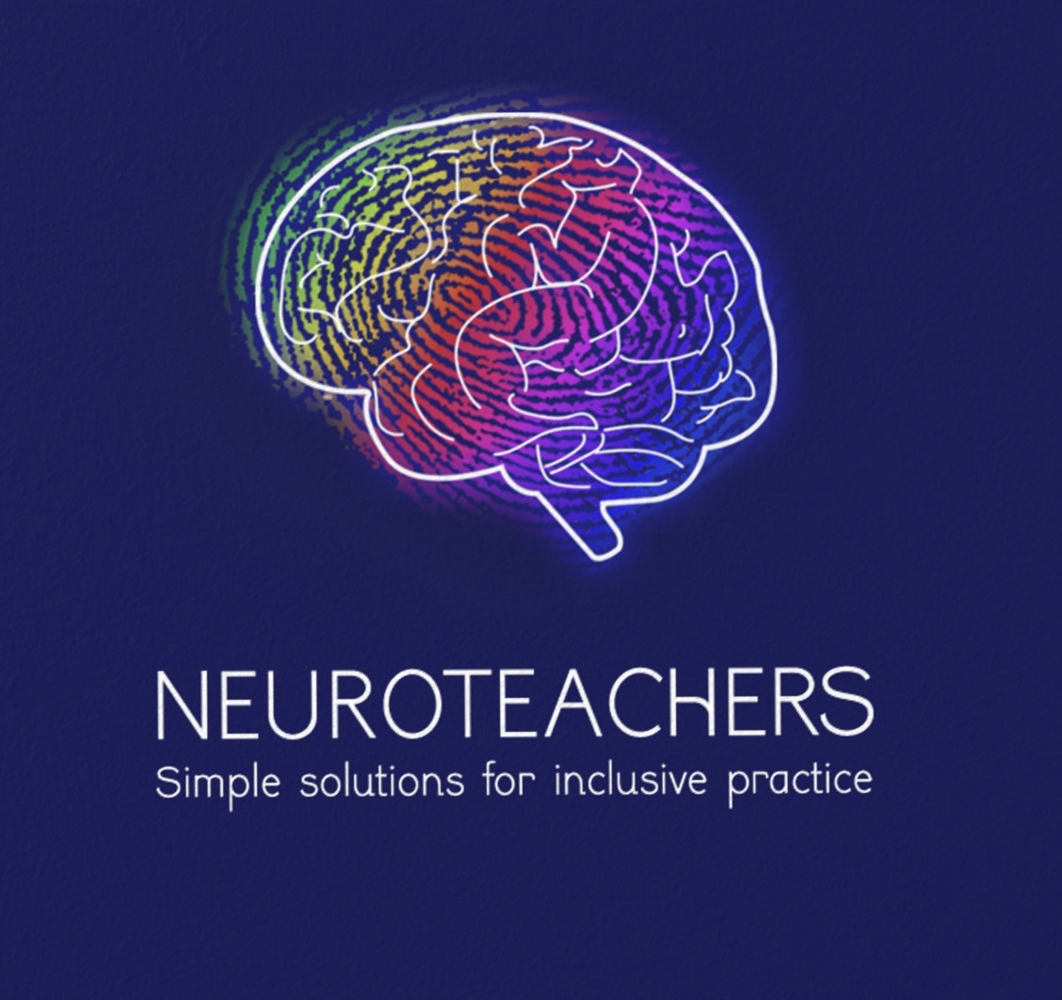
An Introduction By Catrina Lowri
Autism Spectrum Condition

Slide 2
What we will be covering today
-What is autism?
-Understanding the diversity in neurodiversity
-introduction to the sensory system
-Introduction to communication
-Introduction to executive functioning
-Introduction to processing
-Practical tips for working with your pupils
-Q and A session

Slide 3
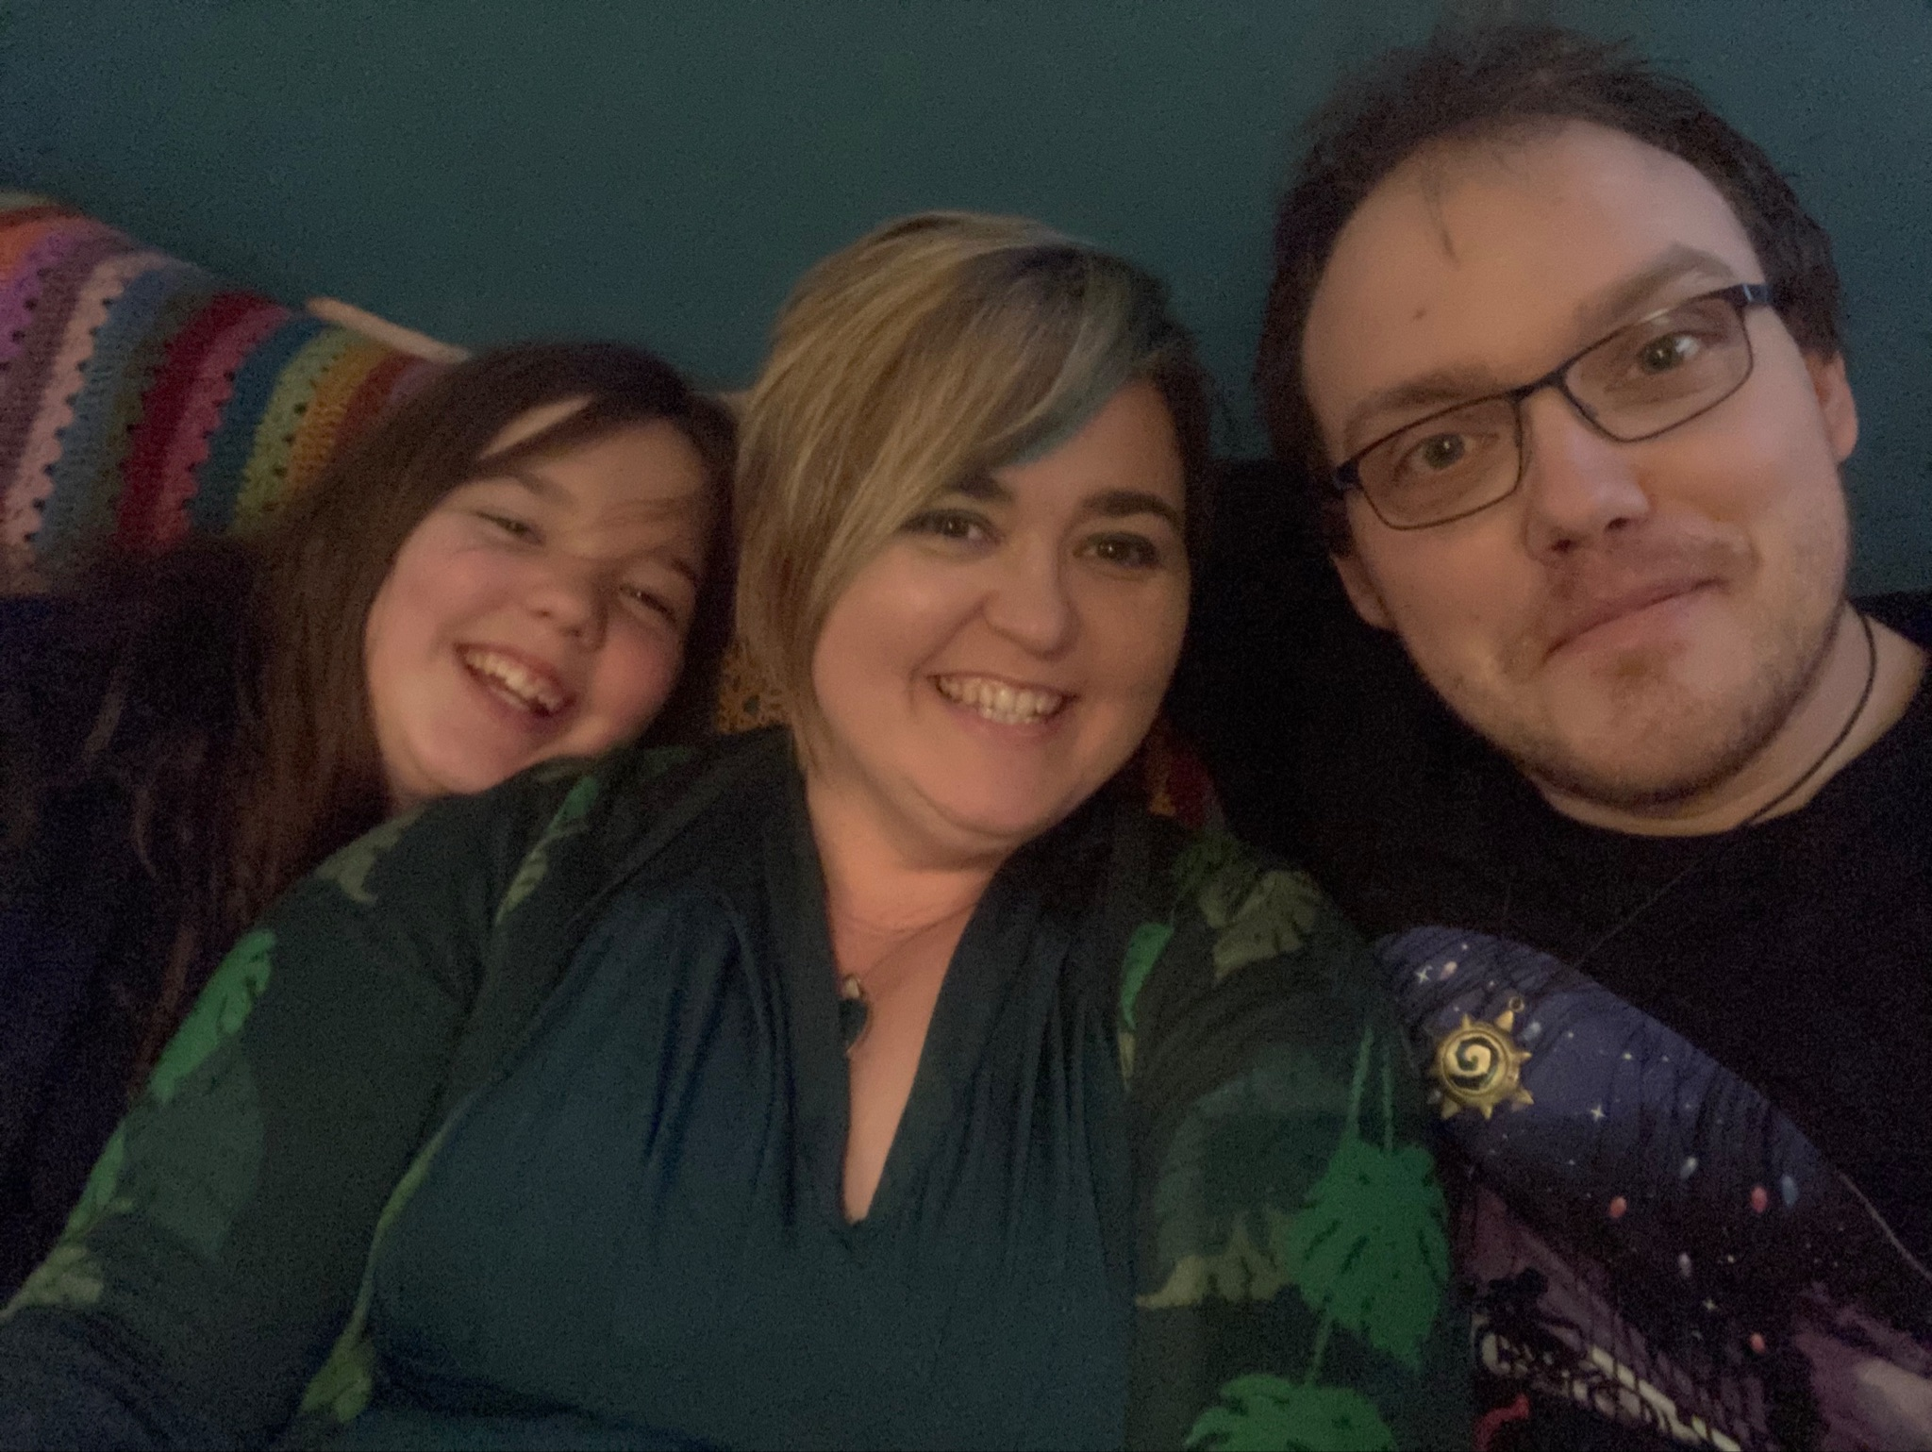
Why am I telling you this?
The Family with 4 Last Names
Notes:
This is a picture taken at Christmas of my family and me. One interesting fact about us is that we all have different last names even the dog! This is my daughter; Nola Lyle, My partner Craig Wakeley and our dog Roxie Hart. Roxie was named after character in then musical Chicago as she looks a lot like Renee Zellwgeger in that film. She even has the bobbed hair cut.

Slide 4
Who and what?
Who?
Catrina Lowri; experienced SENCO, qualified SEND teacher and founder of Neuroteachers. I am Neurodivergent myself; dyslexic and bipolar.
What?
-We will begin this introduction to Autism by talking about your ‘child in mind’. Then discuss the neurology, communication needs, sensory difference, special interests and behaviour.

Slide 5
-Your ‘child in mind’
Notes:
Throughout this talk I would like you to have a particular ‘child in mind’ . Think of a child you believe may be neurodivergent. This could be one of your key children, or another child in your room or nursery. Maybe it’s your own child or a member of the family. Perhaps they are the son or daughter of a friend of yours. During the video I’d like you try and answer two questions for this child; what are my hopes and aspirations for the child? How could I help support them to achieve this?

Slide 6
True or false?
Around 1 in 28 of the population has an autism spectrum condition or social communication disorder
Autism is new condition
More men than women are on the autism spectrum
Autism is curable
It is not possible to teach people with autism
An autism spectrum disorder is difficult to diagnose
Autism has been linked to parental rejection
There are people on the autism spectrum at all rages of ability
If a person can make good eye contact, they are not autistic
People on the autism spectrum are unable to work
The cause of autism is not known
Notes:
Around 1 in 28 of the population has an autism spectrum condition or social communication disorder false ( estimated)
Autism is new condition false ( first described in 1940s)
More men than women are on the autism spectrum true
Autism is curable false
It is not possible to teach people with autism false
An autism spectrum disorder is difficult to diagnose true
Autism has been linked to parental rejection false
There are people on the autism spectrum at all rages of ability false
If a person can make good eye contact, they are not autistic false
People on the autism spectrum are unable to work false
The cause of autism is not known true
An autism spectrum disorder is difficult to diagnose true
Autism has been linked to parental rejection false
There are people on the autism spectrum at all rages of ability false
If a person can make good eye contact, they are not autistic false
People on the autism spectrum are unable to work false
The cause of autism is not known true

Slide 7
‘Autism is a lifelong, developmental disability that affects how a person communicates with and relates to other people, and how they experience the world around them’ National Autistic Society
Notes:
The official definition

Slide 8
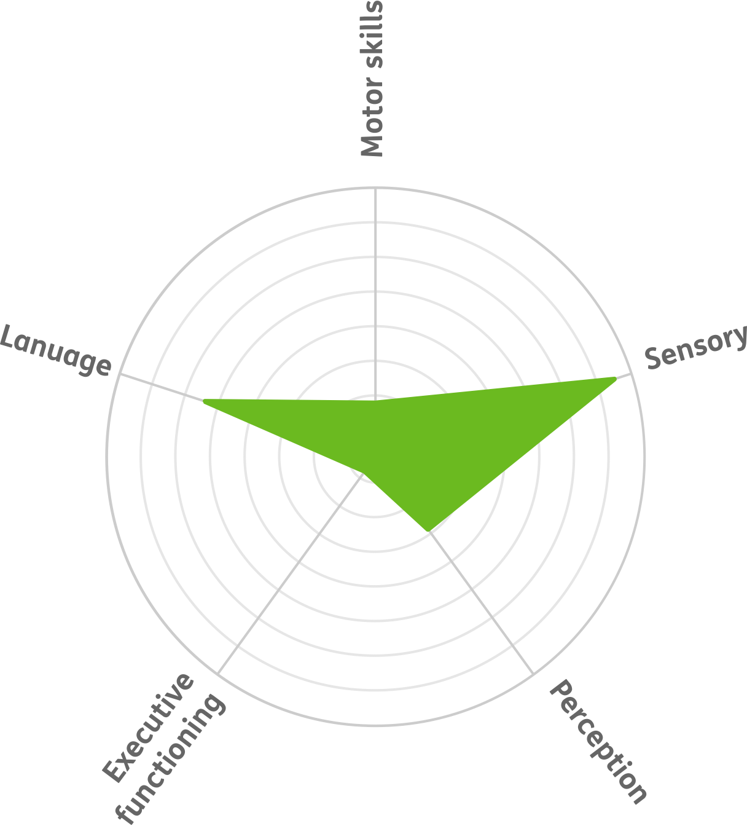
What is autism?
What it can actually look like
Autism is referred to as a ‘spectrum’ because each child experiences autism differently. There is no ‘typical’ autistic child. Every autistic individual has their own strengths and differences, their own life journey, and their own unique story.
What people think autism looks like
Notes:
These radar charts are a good way to visualise the strengths and difficulties that autistic children experience in different areas.
Explain to delegates that a spiky profile means the pupil can have strengths in some areas and challenges in others. For example, a pupil may be very good at drawing or puzzles or talking about their interests but have great difficulties in self-care skills or in understanding how to play with other pupils.

Slide 9
What does autism actually look like?
Notes:
When thinking about your child in mind, you need to consider the following areas of difference; language, motor skills, sensory needs, perception and executive functioning

Slide 10
Activity 1- say what you see
Think of students in your setting with a diagnosis of possible autism spectrum condition or with social communication and interaction difficulties. Describe some of the differences you notice between them and typically developing peers

Slide 11
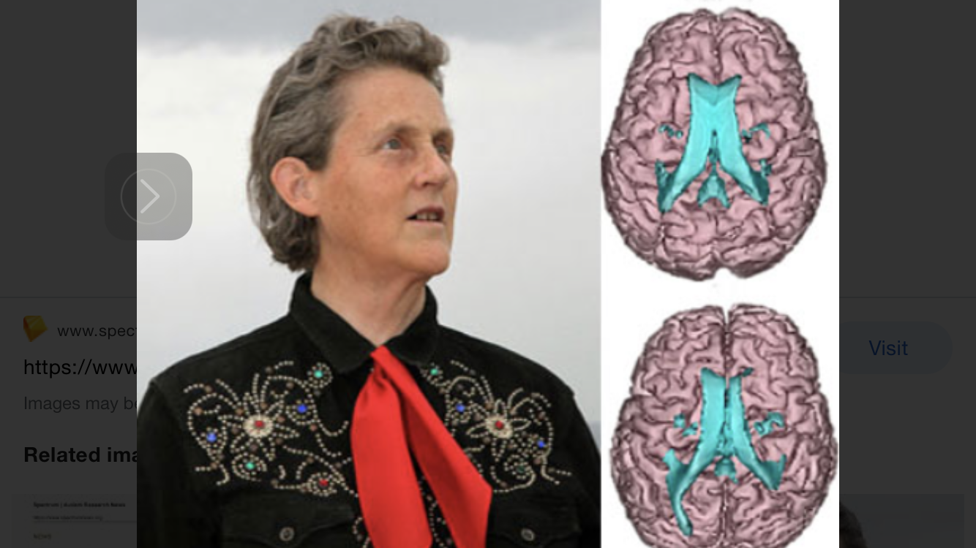
How diverse is Neurodiverse?
Notes:
This is Dr Temple Gradin. She is an agricultural engineer and autism activist. In 2013 she had a series of MRIs carried out at the Uni of Utah for television program call 60 minutes. In this image you can clearly see the difference between Temple’s brain beneath and an NT brain above. The areas highlighted in blue are the speech centre, the larger deltoid shape in the middle and the Amygdala. The Amydala is responsible for producing the stress hormone, cortisol, so we can produce a fight or flight response in order to get away from danger.. In the bottom picture of Temple’s brain you can see that the organ is a lot smaller. The neurology of this means that it can over produce cortisol, causing autistic people to have much higher levels of stress.
The speech centre in the top image, that from the neurotypical, is much smoother and even on both sides, making it easier for messages to get from the thinking part of the brain at the top, to the motor part of the brain at the back. In Temple’s brain we see that the speech centre is enlarged on the left and smaller on the right. Making it much harder for messages to get through. This may be part of the reason why Temple did not speak until she was 3.
Although every brain is as unique as your thumb print, as you can see from these images, the neurdivergent brain processes information in a radically different way. Think about how this might affect your learner in mind. Sadly we can’t scan their brains!

Slide 12
Further reading
Here is an article explaining the difference in Temple Grandin’s brain in more detail.
https://www.spectrumnews.org/news/researchers-reveal-first-brain-study-of-temple-grandin/

Slide 13
Co-occurring conditions
Notes:
It is rare for neurodivergent conditions to occur by themselves. Around 70 percent of neurodivergent people have 2 or more ND conditions. Children may also have a range of physical disabilities such as hearing or visual impairment. Sensory difference is very common amongst ND learners, especially those with Autism or ADHD. There may be associated learning difficulties such as Down Syndrome or Global Developmental delay. Or there may be social, emotional and mental health issues such as attachment disorder, anxiety or depression.

Slide 14
The fruit salad approach
Notes:
This was originally developed for autism and was described by Donna Williams, an Australian, austic writer, singer and activist. She had a number of coocurring conditions including autism which overlapped and joined to make up parts of who she was. The likelihood is that your ND learner will have more than one type of neurdiverisity, for example, I am dyslexic and bipolar. But we all a have a number of aspects to our personality. Whilst our ND should not define us, it could be accepted and celebrated.

Slide 15
Introduction to the Sensory System
The brain processes all the sensory information sent from various sensory systems in the body and helps to organise, prioritise and understand the information.
Question: how many senses are there?

Slide 16
The 8 senses
Taste
Touch
Smell
Sight
Hearing
Proprioception
Vestibular ( balance)
Interception

Slide 17
Sensory Processing
An autistic child may be
Hyper-sensitive (too much input)
Hypo-sensitive (too little input)
Which leads to becoming
A sensory seeker
A sensory avoider

Slide 18
The window of tolerance
Notes:
Mention Dr Dan Siegal and sympathetic and parasympathetic

Slide 19
Introduction to Communication
Difference with Identifying and understanding their own emotions- Alexythemia
May experience the ‘double empathy problem’
Differences with understanding the unwritten social rules – e.g. taking turns, waiting, queuing, personal space, group work
Differences with sharing the enjoyment or interests of others …. Negotiating and compromising
Differences with forming and maintaining friendships

Slide 20
Activity 2- non verbal communication
Notes:
Difficulty Identifying and understanding their own emotions
Difficulty with ‘ Theory of Mind/Mind Blindness
Difficulty understanding the unwritten social rules – e.g. taking turns, waiting, queuing, personal space, group work
Difficulty sharing the enjoyment or interests of others …. Negotiating and compromising
Difficulty with forming and maintaining friendships
Autistic children may have;
Delayed speech and language skills
Expressive language in advance of understanding
Unusual intonation and rhythm, difficulty with volume or accent
Unresponsive to verbal instructions
May be overwhelmed by too much language
Semantic and literal interpretation – e.g. difficulty understanding abstract language, such as jokes, idioms and words with multiple meanings and sacrasm
Difficulty understanding pragmatic language

Slide 21
Autistic children may have;
Delayed speech and language skills
Expressive language in advance of understanding
Unusual intonation and rhythm, difficulty with volume or accent
Unresponsive to verbal instructions
May be overwhelmed by too much language
Semantic and literal interpretation – e.g. difficulty understanding abstract language, such as jokes, idioms and words with multiple meanings and sarcasm
Difficulty understanding pragmatic language

Slide 22
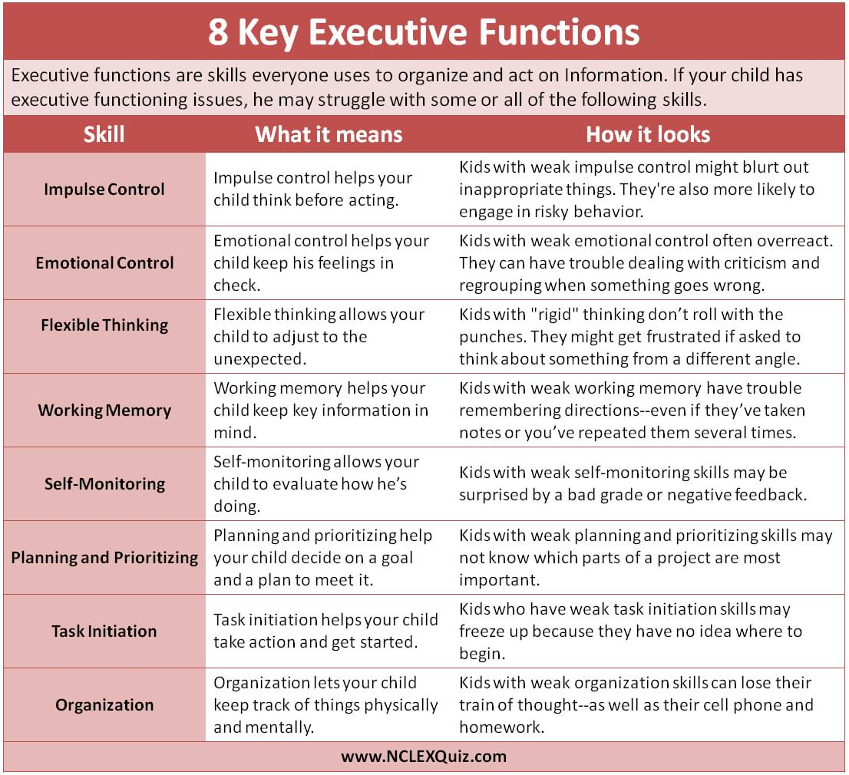
Introduction to Executive functioning

Slide 23
Executive functioning and perception may mean differences with-
Managing change and transitions
Generalising skills or knowledge
Starting or finishing a task
Playing imaginatively
Unstructured time
Engaging in activities they do not appeal to them
Accepting the views of others
Managing more than one sense at a time, e.g. looking and listening
Over adherence to rules / strong sense of justice

Slide 24
Restricted, repetitive patterns of behaviour, interests, or activities
Notes:
Managing change and transitions
Generalising skills or knowledge
Starting or finishing a task
Playing imaginatively
Unstructured time
Engaging in activities they do not appeal to them
Accepting the views of others
Managing more than one sense at a time, e.g. looking and listening
Over adherence to rules / strong sense of justice

Slide 25
Activity 3 – special interests are a gift- use them!
Think of a child that you work with who has a special interest. How could you use that to engage them with learning?
Notes:
The story of Alice and Human Sacrifice

Slide 26
Challenges can arise
People with autism have raised levels of cortical compared with typically developing peers
Creating an autism friendly environment can reduce stress and therefore reduce challenging behaviour
( McDonnell 2014)

Slide 27
Introduction to processing

Slide 28
Processing of Language
Processing language can take much longer for those with communication needs especially within busy distracting environments
STRATEGY: Allow time for processing (6 or 10 second rule)

Slide 29
Attention and Listening Skills
Being able to listen and attend is vital for the development of communication skills
STRATEGY: If your child has difficulty in listening and attending to language, try:
Using their name first
Provide a physical prompt
Giving one instruction at a time
Simple sentences
Gain their attention – eye contact is overated

Slide 30
Key Words and Ideas
Consistency
Structure
Visual
Reinforcement
Motivation
Modified Language

Slide 31
How could you use this information to help your child in mind?

Slide 32
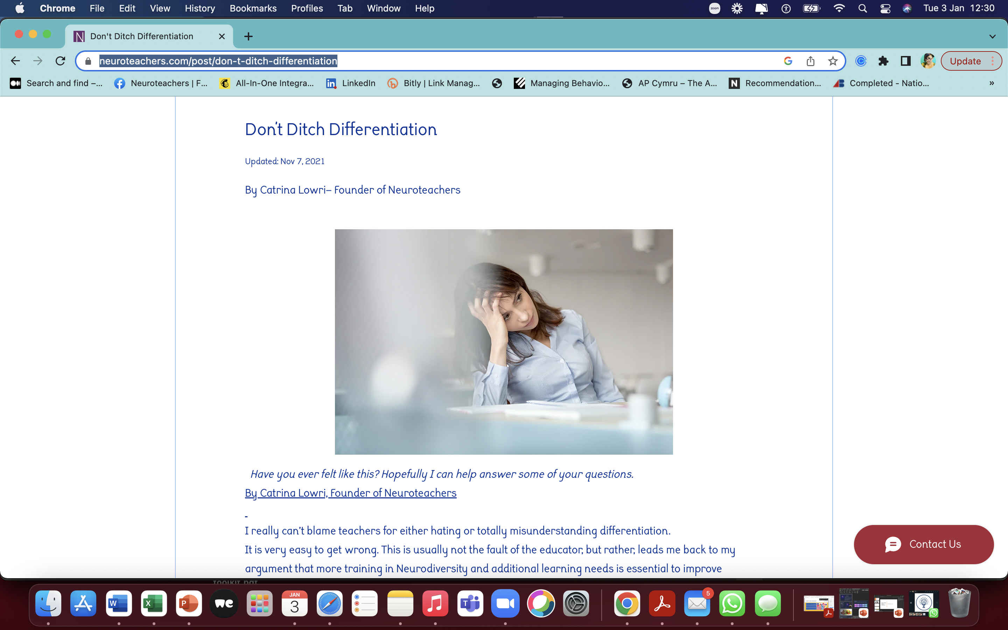
Shameless plug!
https://www.neuroteachers.com/post/don-t-ditch-differentiation

Slide 33
Summary
Understand features of autism
Know your pupil and their interests
Apply key words and ideas
Prevent anxiety

Slide 34
Thanks!
Contact us:
Catrina Lowri
www.neuroteachers.com
Facebook https://www.facebook.com/groups/762451187641854
Linkedin https://www.linkedin.com/in/catrina-anne-lowri-32a7791b2/
Twitter @neuroteachers
Instagram @neuroteachersuk
YouTube https://www.youtube.com/@neuroteachers7746

Slide 35
Useful resources
Autism Education Trust
Standards for Schools
https://www.autismeducationtrust.org.uk/resources/aet-schools-standards-framework#:~:text=The%20Schools%20Standards%20Framework%20can,plan%20and%20implement%20improvement%20processes.
Competency framework
https://www.autismeducationtrust.org.uk/resources/aet-schools-competency-framework
Progression framework
https://www.autismeducationtrust.org.uk/resources/progression-framework

Slide 36
References
Are you autistic? Channel 4 2018
Inclusion Development Programme link available on www.nasen.org.uk
Autistic Spectrum Disorders: Good Practice Guidance. DfES/597/2002/REV
AS Early Years / Primary / Secondary box – available from the C&I team website
www.autism.org.uk (National Autistic Society)
www.autismeducationtrust.org.uk
Amythyst Schaber: Ask An Autistic (on YouTube) and www.neurowonderful.com
The girl with the curly hair project
McDonnel 2014

