Slide 1
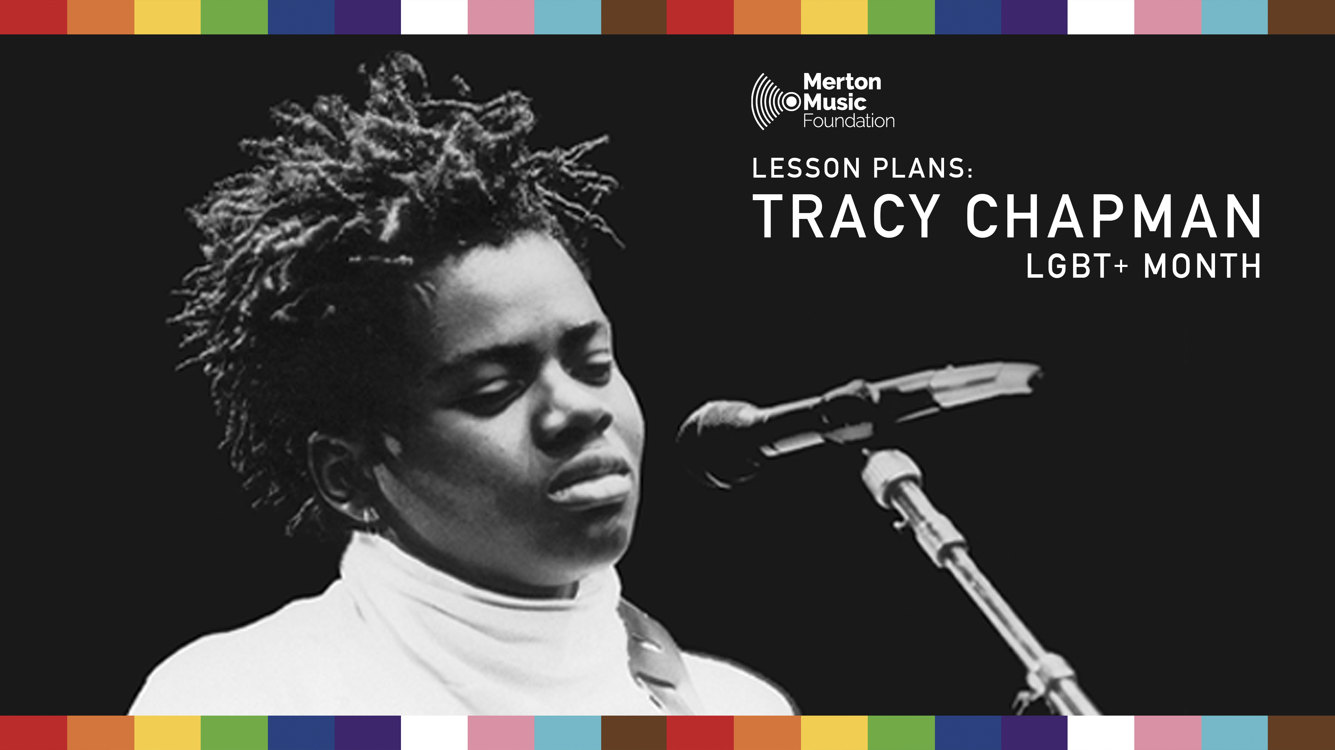

Notes:
This PowerPoint is designed to accompany MMF’s Tracy Chapman lesson plan for LGBT+ History Month, for children in Key Stage 2. Please feel free to adapt/edit as necessary for your class or lesson.

Slide 2

Learning Objectives
1. To learn about the life and identity of Tracy Chapman
2. To sing a Tracy Chapman song
3. To write lyrics about identity
Notes:
Prompt questions-
-What does this quote mean to you? -What might this quote mean to the LGBT+ community? (Opportunity for wider discussion/context about the LGBT+ community is if needed)

Slide 3
‘I’d like to live as if only love mattered.’
At This Point in My Life by Tracy Chapman

Slide 4
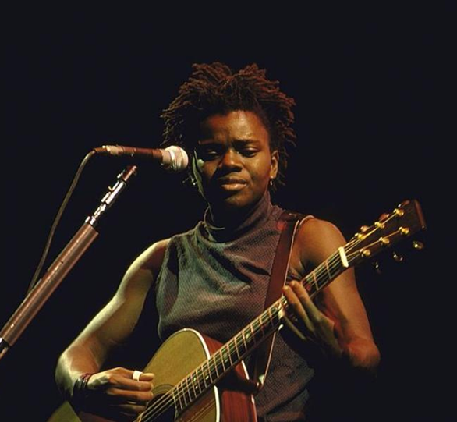
Tracy Chapman
- Tracy Chapman is an African American singer songwriter
- She was born in Ohio in the 1960s
- She started to play the ukulele aged 3 and was playing guitar and writing songs by the time she was 8
- She is widely known and accepted as a lesbian
Notes:
Tracy Chapman is an African American singer songwriter who rose to popularity in the 1980’s. She is a multi-award winning, platinum artist. Throughout her career she has been a pioneer for social justice and change.
She was born in Ohio in 1964. She started to learn ukulele aged 3 and by the age of 8 was playing guitar and writing her own songs.
She is also widely known/accepted as a lesbian, although she never spoke to the press officially about her sexuality.

Slide 5
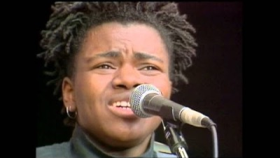
‘Talkin’ Bout a Revolution’
Notes:
Possible prompt questions: -What do you think the song might be about? -What do you think the lyrics meant to Tracy Chapman? -What do the lyrics mean to you? -How many times does she sing ‘like a whisper’

Slide 6
‘Talkin’ Bout a Revolution’ lyrics
Don’t you know, they’re talkin' bout a revolution
It sounds like a whisper
Don’t you know they’re talkin' bout a revolution
It sounds like a whisper
Notes:
Singing as a class tips: -Speak each line of the chorus first, tapping the syllables. -Sing each line individually as a call and response. -Sing the chorus as a class unaccompanied. -Sing the chorus as a class with the backing track/YouTube performance.

Slide 7

Intersectionality
Notes:
Discuss how intersectionality is looking at a person’s different identities, and how they relate to each other as a whole, rather than individual characteristics cite Kimberly Crenshaw. This may cause challenges in people’s lives, but also may make them unique.
Prompt questions - What are some of the different elements of our own identities?
How do they make us unique? What makes us different and what makes us similar?
Optional activity: Complete ‘Puzzle Pieces’ worksheet- pupils fill in different puzzle pieces with different elements that make up their identity. Activity can be completed whilst listening to Tracy Chapman playlist.

Slide 8

Writing our own lyrics – ‘In My Power’
Notes:
Discussion of how song writing is a tool that artists like Tracy Chapman can use to explore their own identity, speak their truth, and pioneer change. It can allow people to express themselves. Using the lyric writing worksheet, children can create a four-line chorus with the title ‘In My Power!’, about what their own identity and what makes them unique.
Have ‘In My Power!’ backing track playing whilst pupils write their chorus. After writing the lyrics, pupils can practice performing their chorus as a rap over the backing track.

